Slide 1
IMPORTANT!!!
You must have the proper fonts installed in order for this presentation to work correctly. They are free from Google and links are found here:
Montserrat: https://fonts.google.com/specimen/Montserrat
Montserrat Alternatives: https://fonts.google.com/specimen/Montserrat+Alternates
Raleway: https://fonts.google.com/specimen/Raleway
Lora: https://fonts.google.com/specimen/Lora
Oswald: https://fonts.google.com/specimen/Oswald
Once installed, this slide can be hidden or deleted.

Slide 2
Lesson 1
Copyright 2023 © Child Evangelism Fellowship of Europe. All rights reserved.

Slide 3
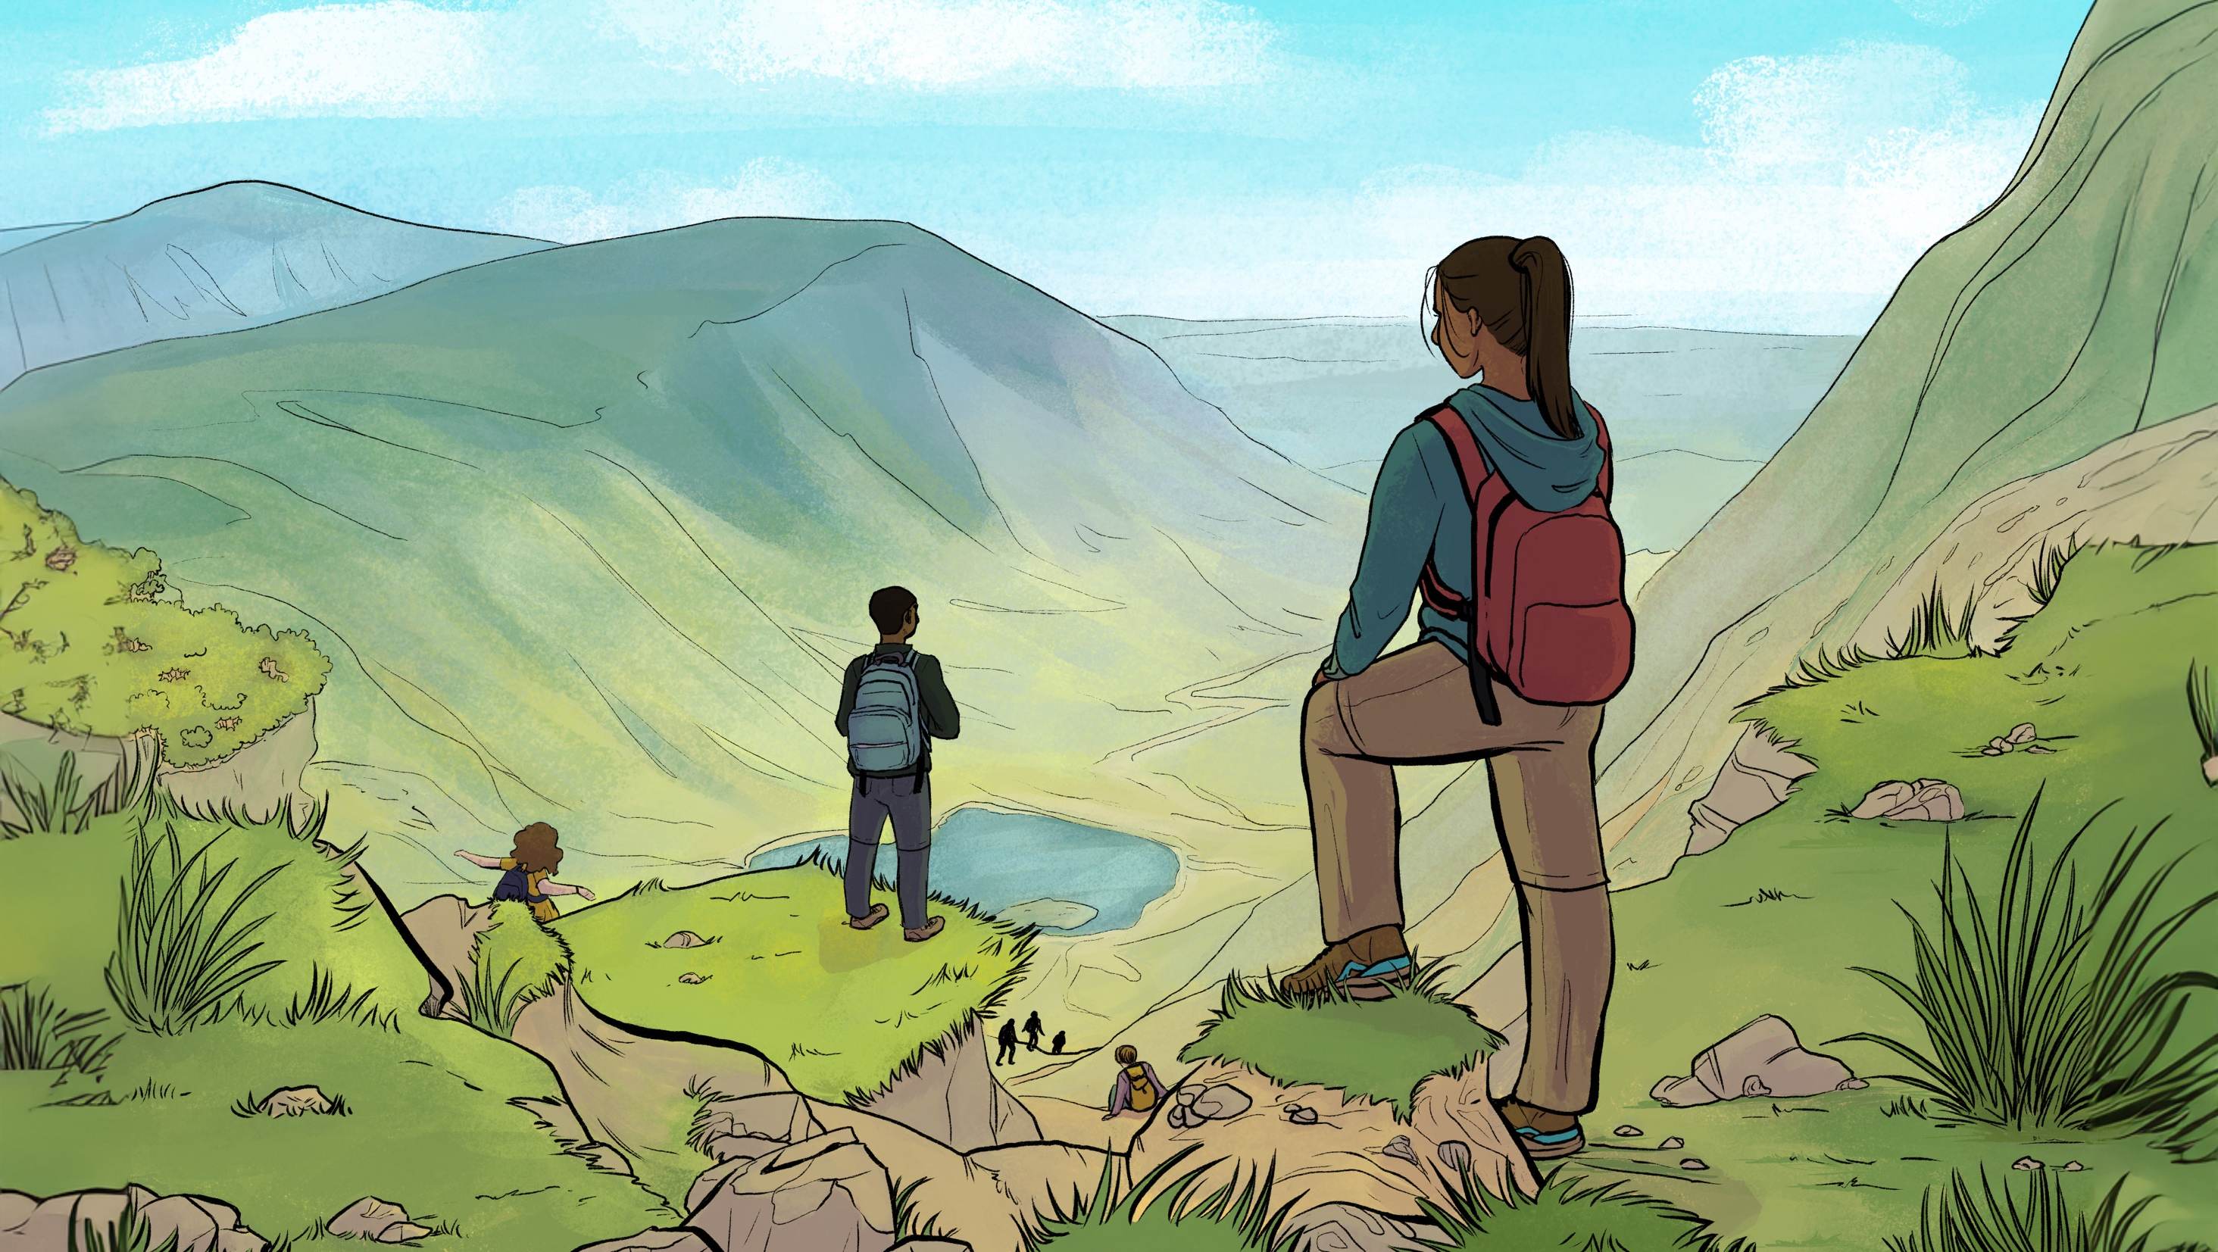
Who is Jesus?
Why follow Him?
Is He calling you to follow Him?
How can I become a follower of Jesus?
Visual 1

Slide 4
Copyright 2023 © Child Evangelism Fellowship of Europe. All rights reserved.

Slide 5
Lesson 2
Copyright 2023 © Child Evangelism Fellowship of Europe. All rights reserved.

Slide 6
WHO
AM I?
Visual 2

Slide 7
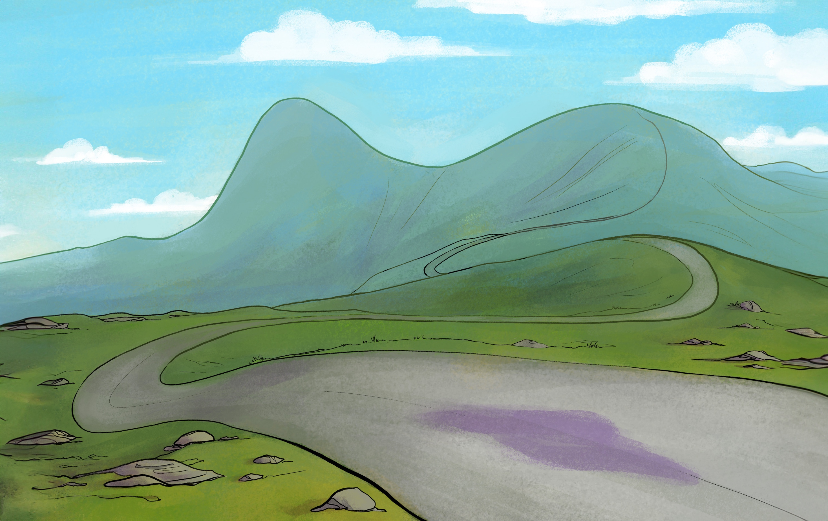
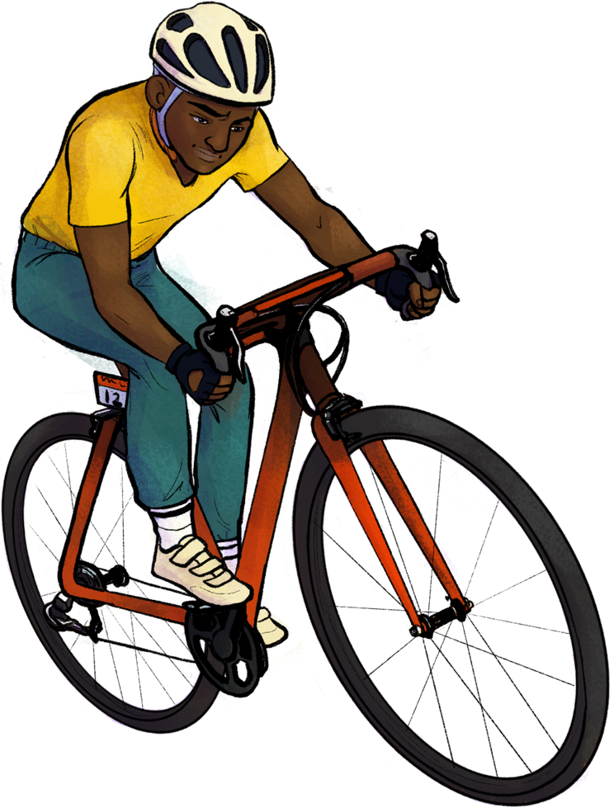
Weak faith
Matthew 14:22-32
Meets Jesus
JOHN 1:41-42
Profession of faith
Matthew 16:13-17
His birth
PSALM 51:5
Peter
Changed forever
Visual 3

Slide 8
Who is Jesus?
“Jesus was only a perfect man, not God in flesh. He did not rise from the dead in His physical body, but as a spirit. He did not die on a cross but on a stake.”
Jehovah’s Witness
Visual 4

Slide 9
Who is Jesus?
“Jesus was a very great prophet, second only to Muhammad. He is not the Son of God. He was not crucified.”
A Muslim (Islam)
Visual 4

Slide 10
Who is Jesus?
“He was just a good teacher and a good man, but that is all.”
Visual 4

Slide 11
Who is Jesus?
“Jesus was a myth …
a human fabrication.”
Visual 4

Slide 12
Who is Jesus?
“You are the Christ,
the Son of the living God”.
Peter
Visual 4

Slide 13
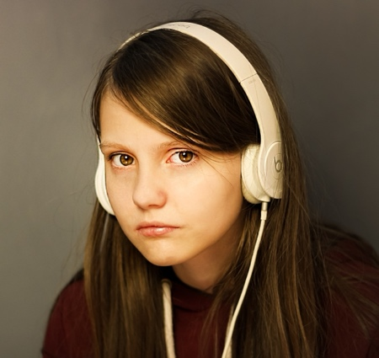
Who is Jesus?
What is your answer?
Visual 4

Slide 14
Copyright 2023 © Child Evangelism Fellowship of Europe. All rights reserved.

Slide 15
Lesson 3
Copyright 2023 © Child Evangelism Fellowship of Europe. All rights reserved.

Slide 16
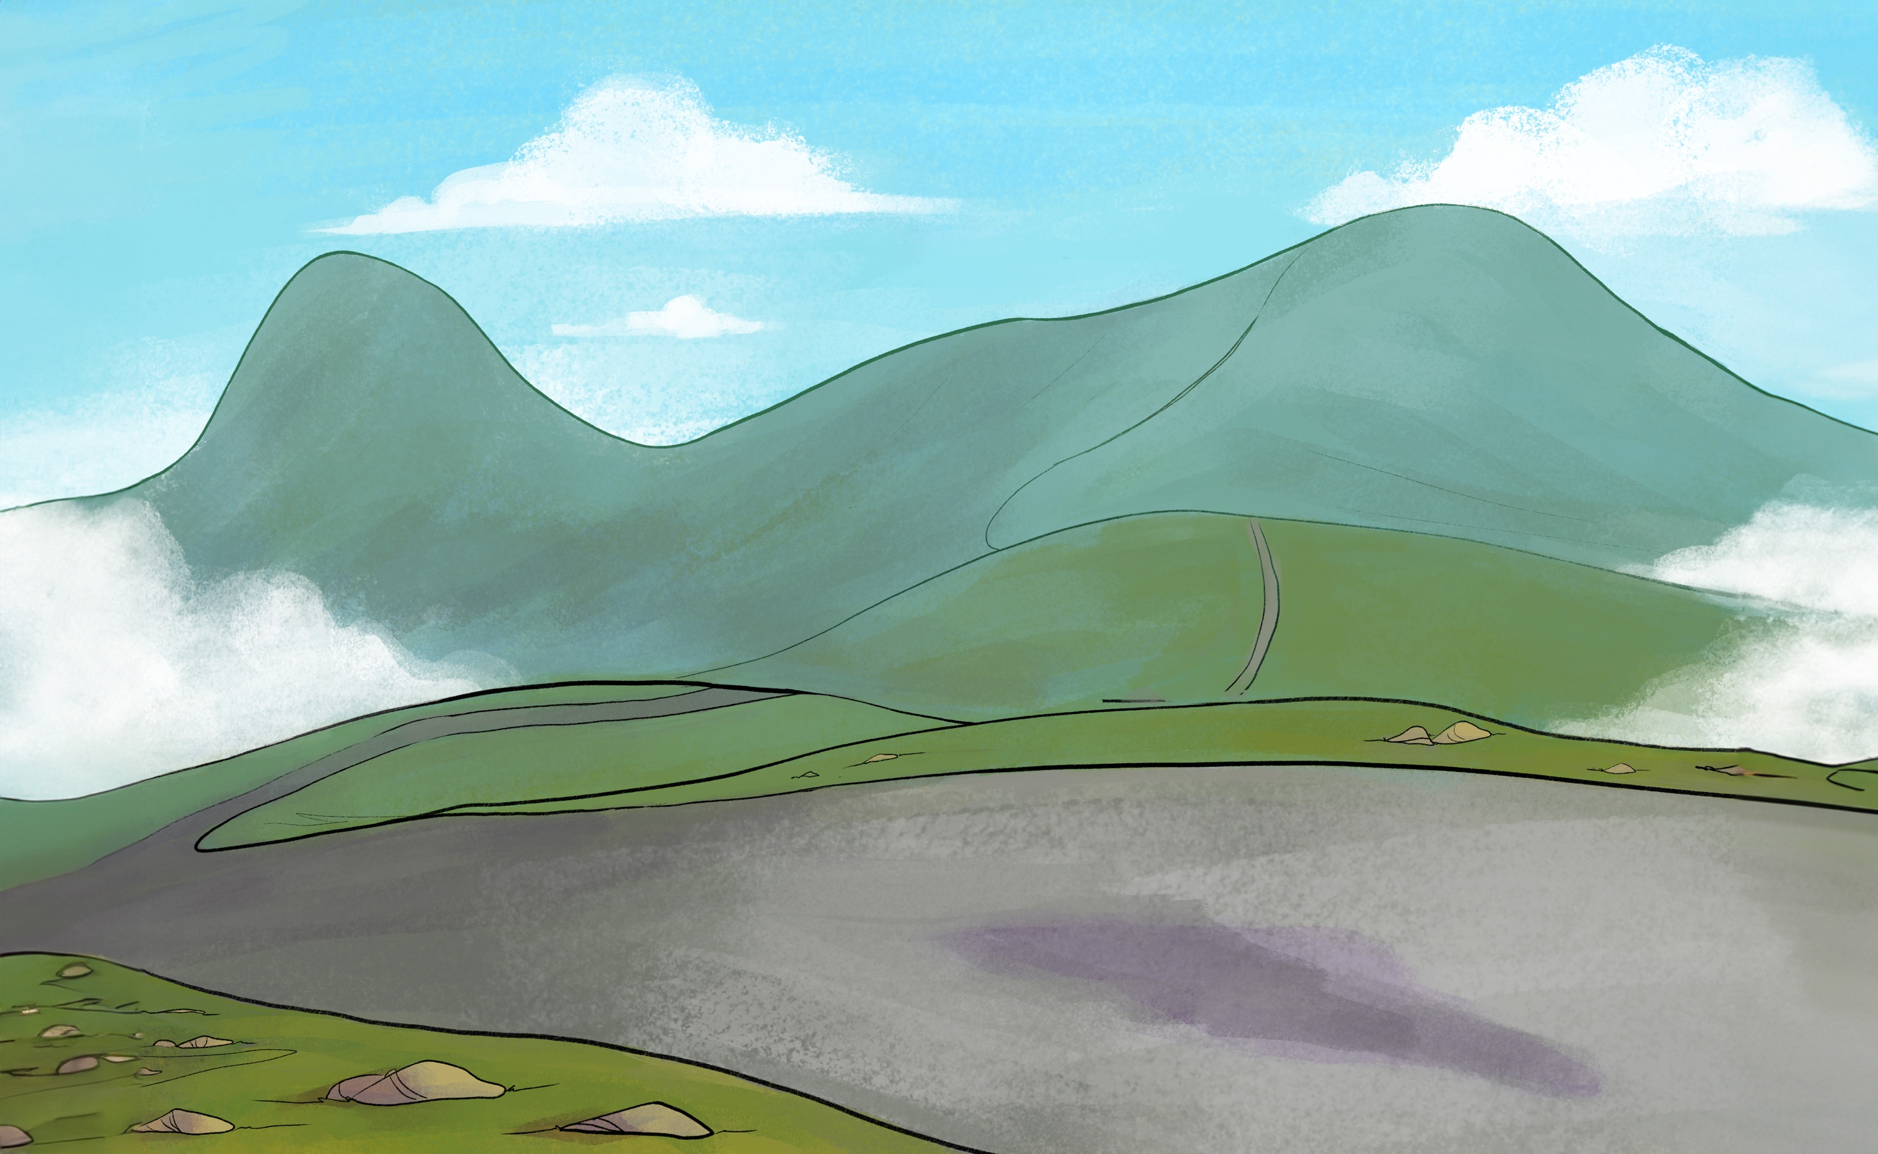
Restoration to Christ
John 21:15-17
Denial of Christ
Matthew 26:69-75
Boldness to proclaim Christ
Acts 2:14-15, 37-41
Profession of faith
Matthew 16:13-17
Peter
Failures and victory
Visual 5

Slide 17
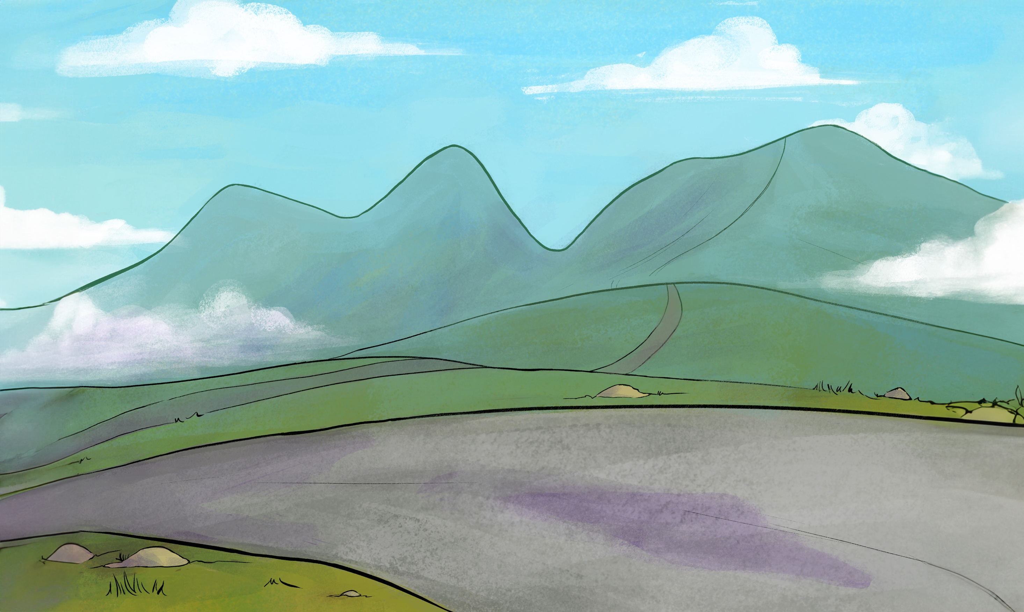
Profession of faith
Matthew 16:13-17
Restoration to Christ
John 21:15-17
Meets Jesus
JOHN 1:41-42
Boldness to proclaim Christ
Acts 2:14-15, 37-41
Weak faith
Matthew 14:22-32
Denial of Christ
Matthew 26:69-75
His birth
PSALM 51:5
Peter
Failures and victory
Visual 6

Slide 18
Copyright 2023 © Child Evangelism Fellowship of Europe. All rights reserved.

Slide 19
Lesson 4
Copyright 2023 © Child Evangelism Fellowship of Europe. All rights reserved.

Slide 20
WHO
AM I?
Visual 2

Slide 21
John
Following the Lord
Learning from the Lord
Serving the Lord
Visual 7

Slide 22
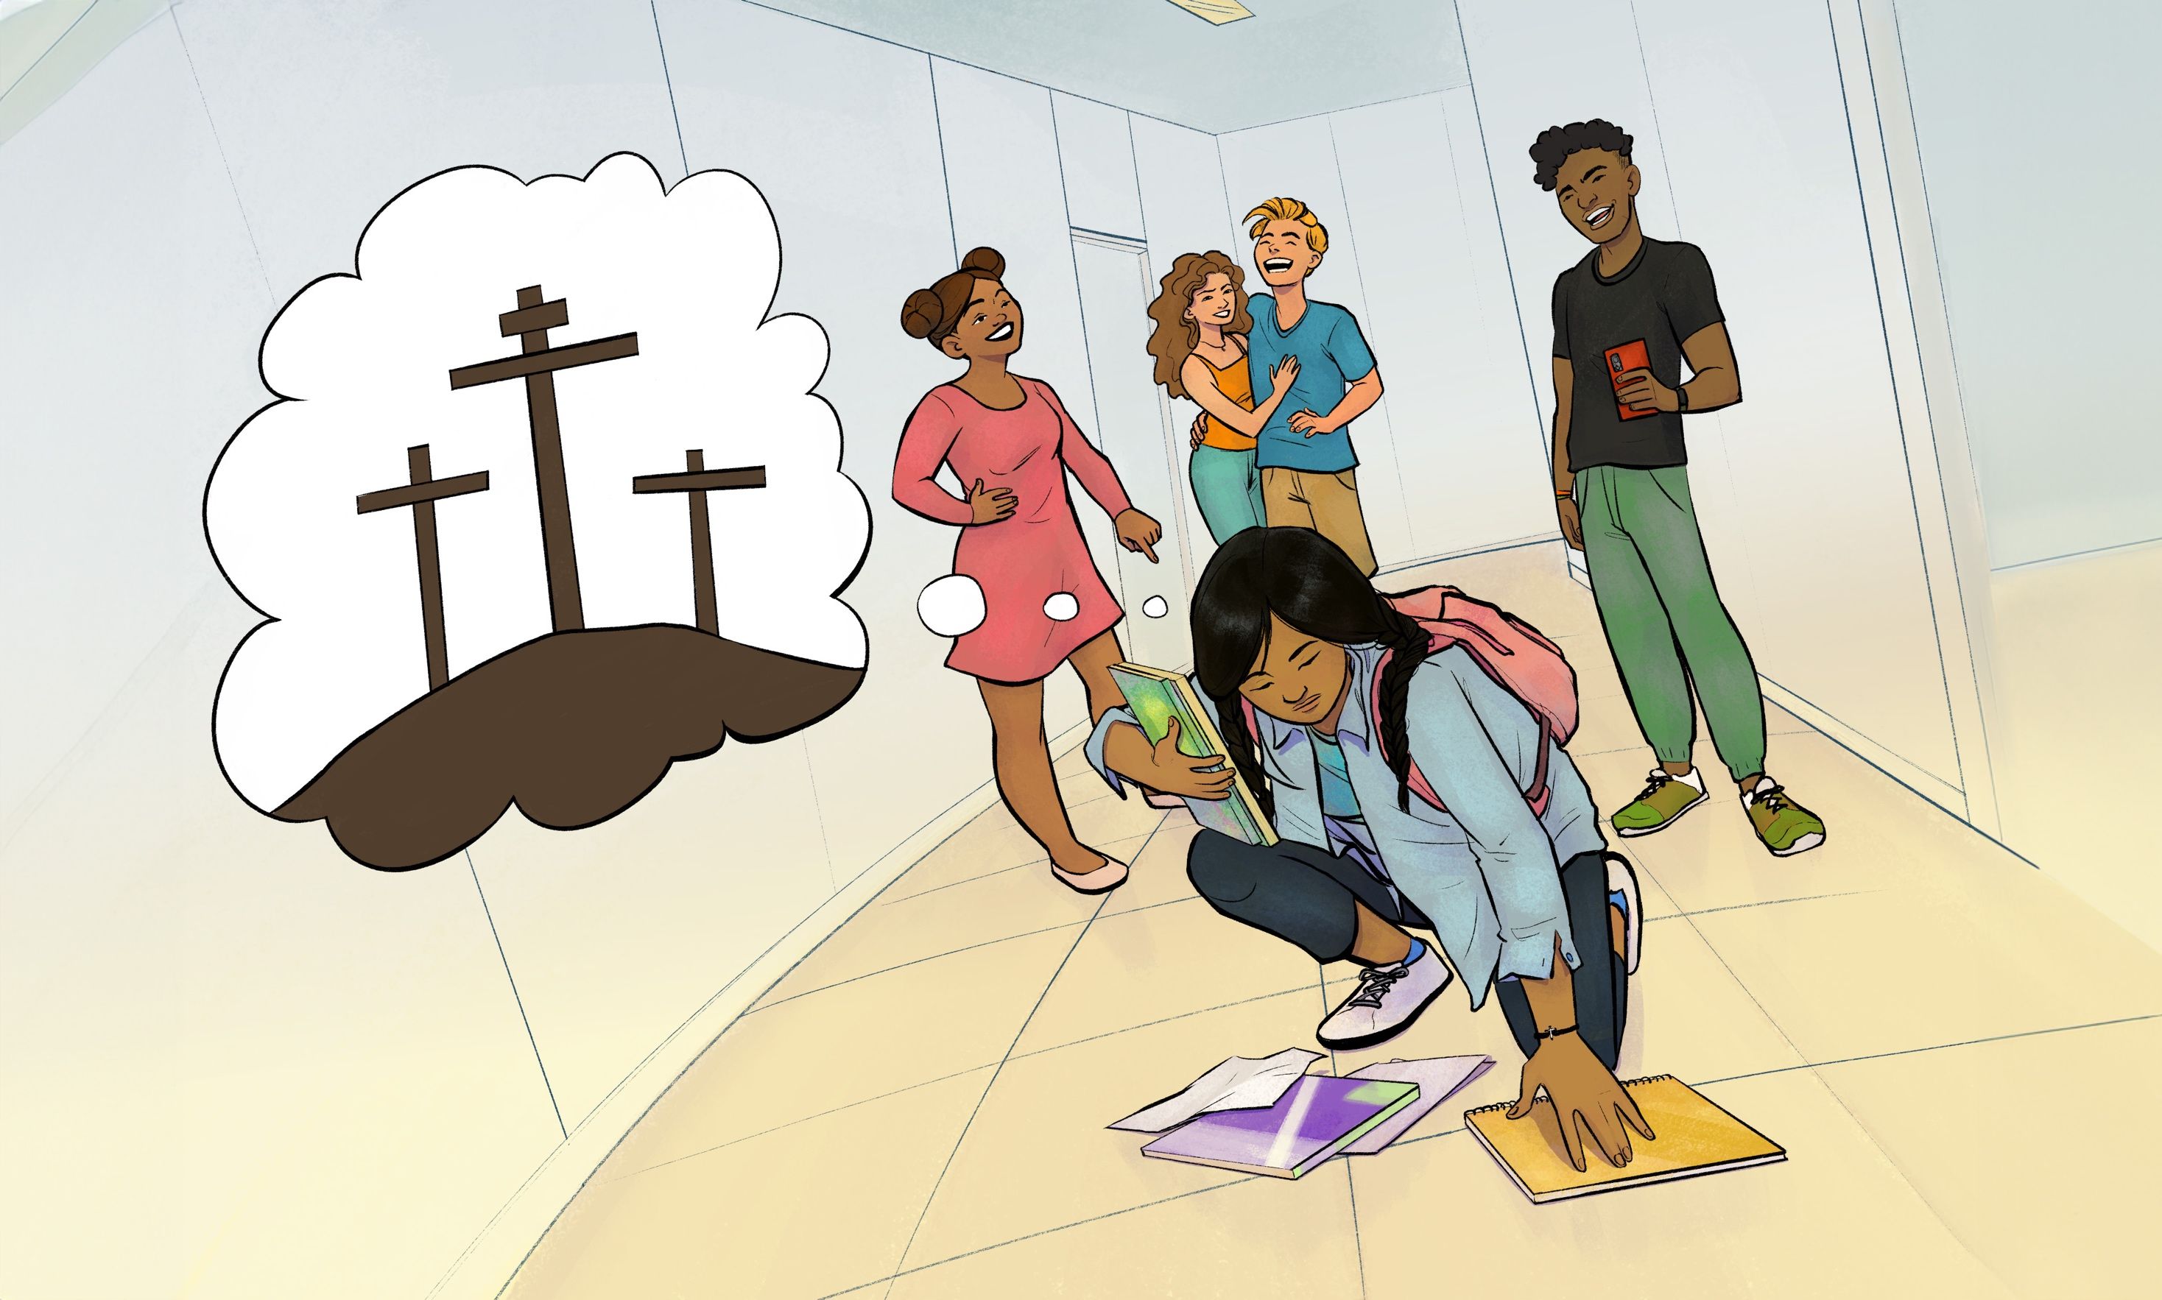
Visual 8

Slide 23
Copyright 2023 © Child Evangelism Fellowship of Europe. All rights reserved.

Slide 24
Lesson 5
Copyright 2023 © Child Evangelism Fellowship of Europe. All rights reserved.

Slide 25
John
John in later life
The book of Revelation
The second coming of Christ
Visual 9

Slide 26
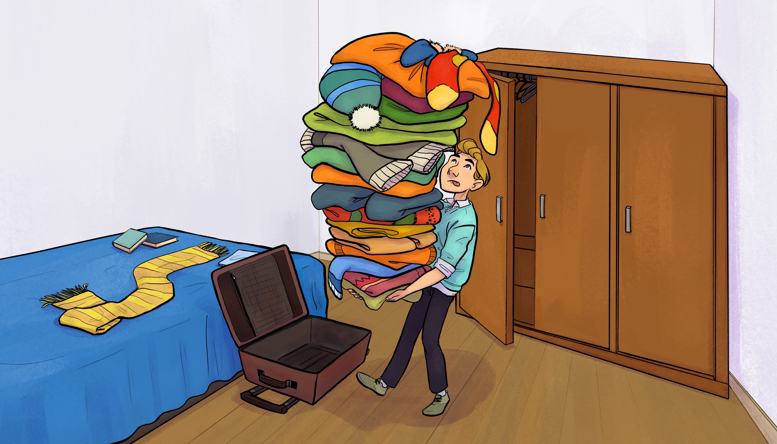
Visual 10

Slide 27
John
Death
Judgement
New Jerusalem
Visual 11

Slide 28
Copyright 2023 © Child Evangelism Fellowship of Europe. All rights reserved.

Slide 29
Lesson 6
Copyright 2023 © Child Evangelism Fellowship of Europe. All rights reserved.

Slide 30
WHO
AM I?
Visual 2

Slide 31
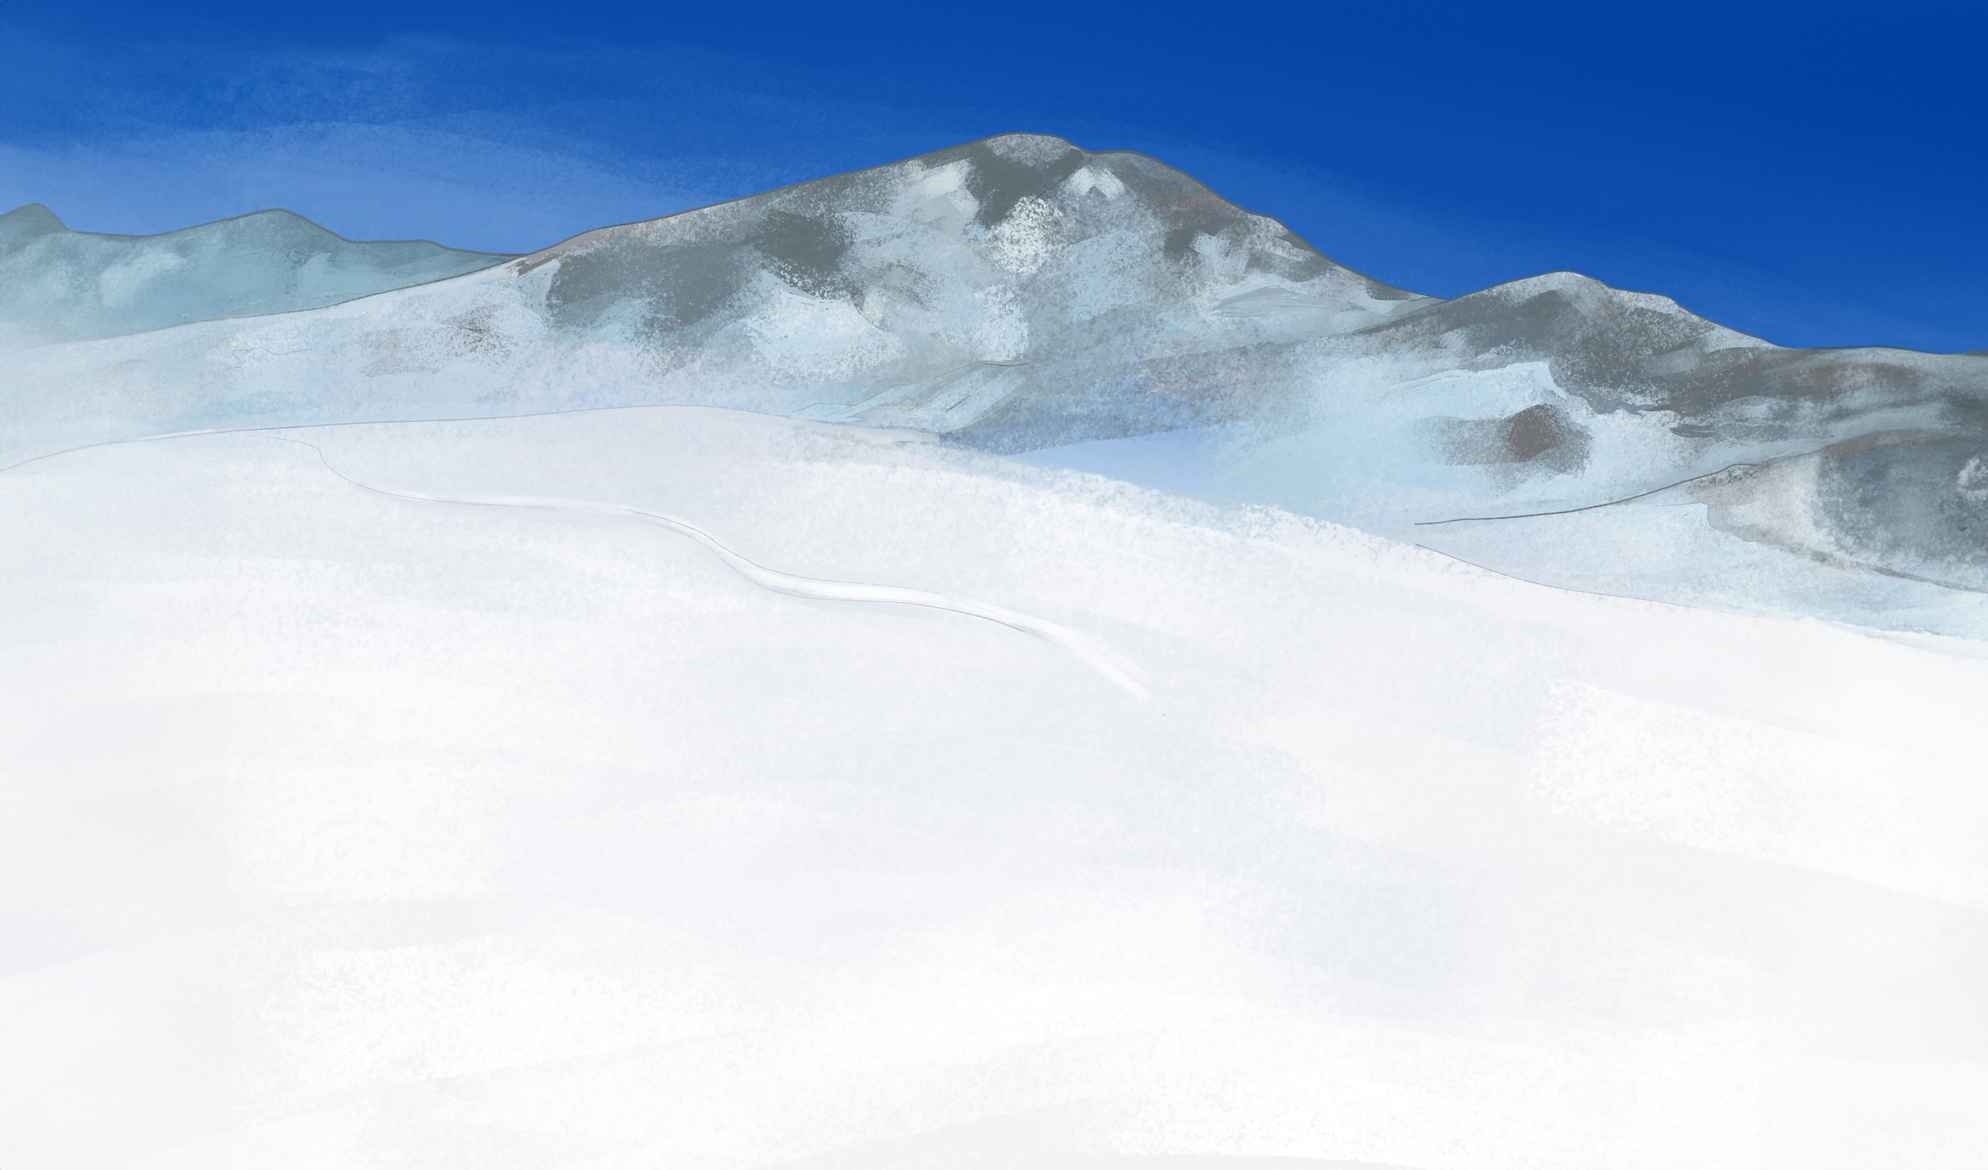
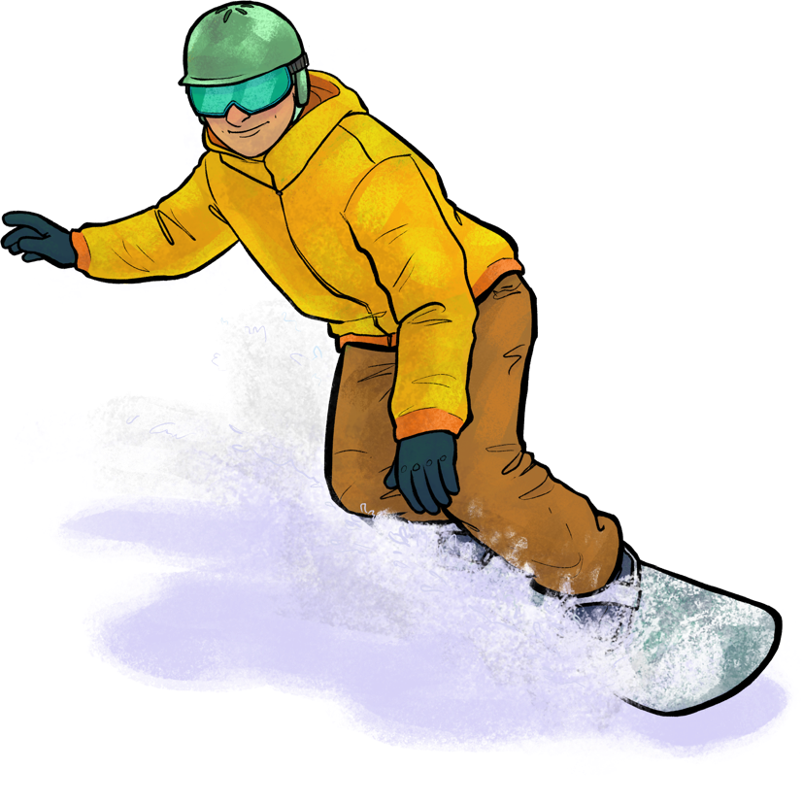
Judas
He fooled the others
He ignored the truth
He put money first
Visual 12

Slide 32
Copyright 2023 © Child Evangelism Fellowship of Europe. All rights reserved.

Slide 33
Lesson 7
Copyright 2023 © Child Evangelism Fellowship of Europe. All rights reserved.

Slide 34
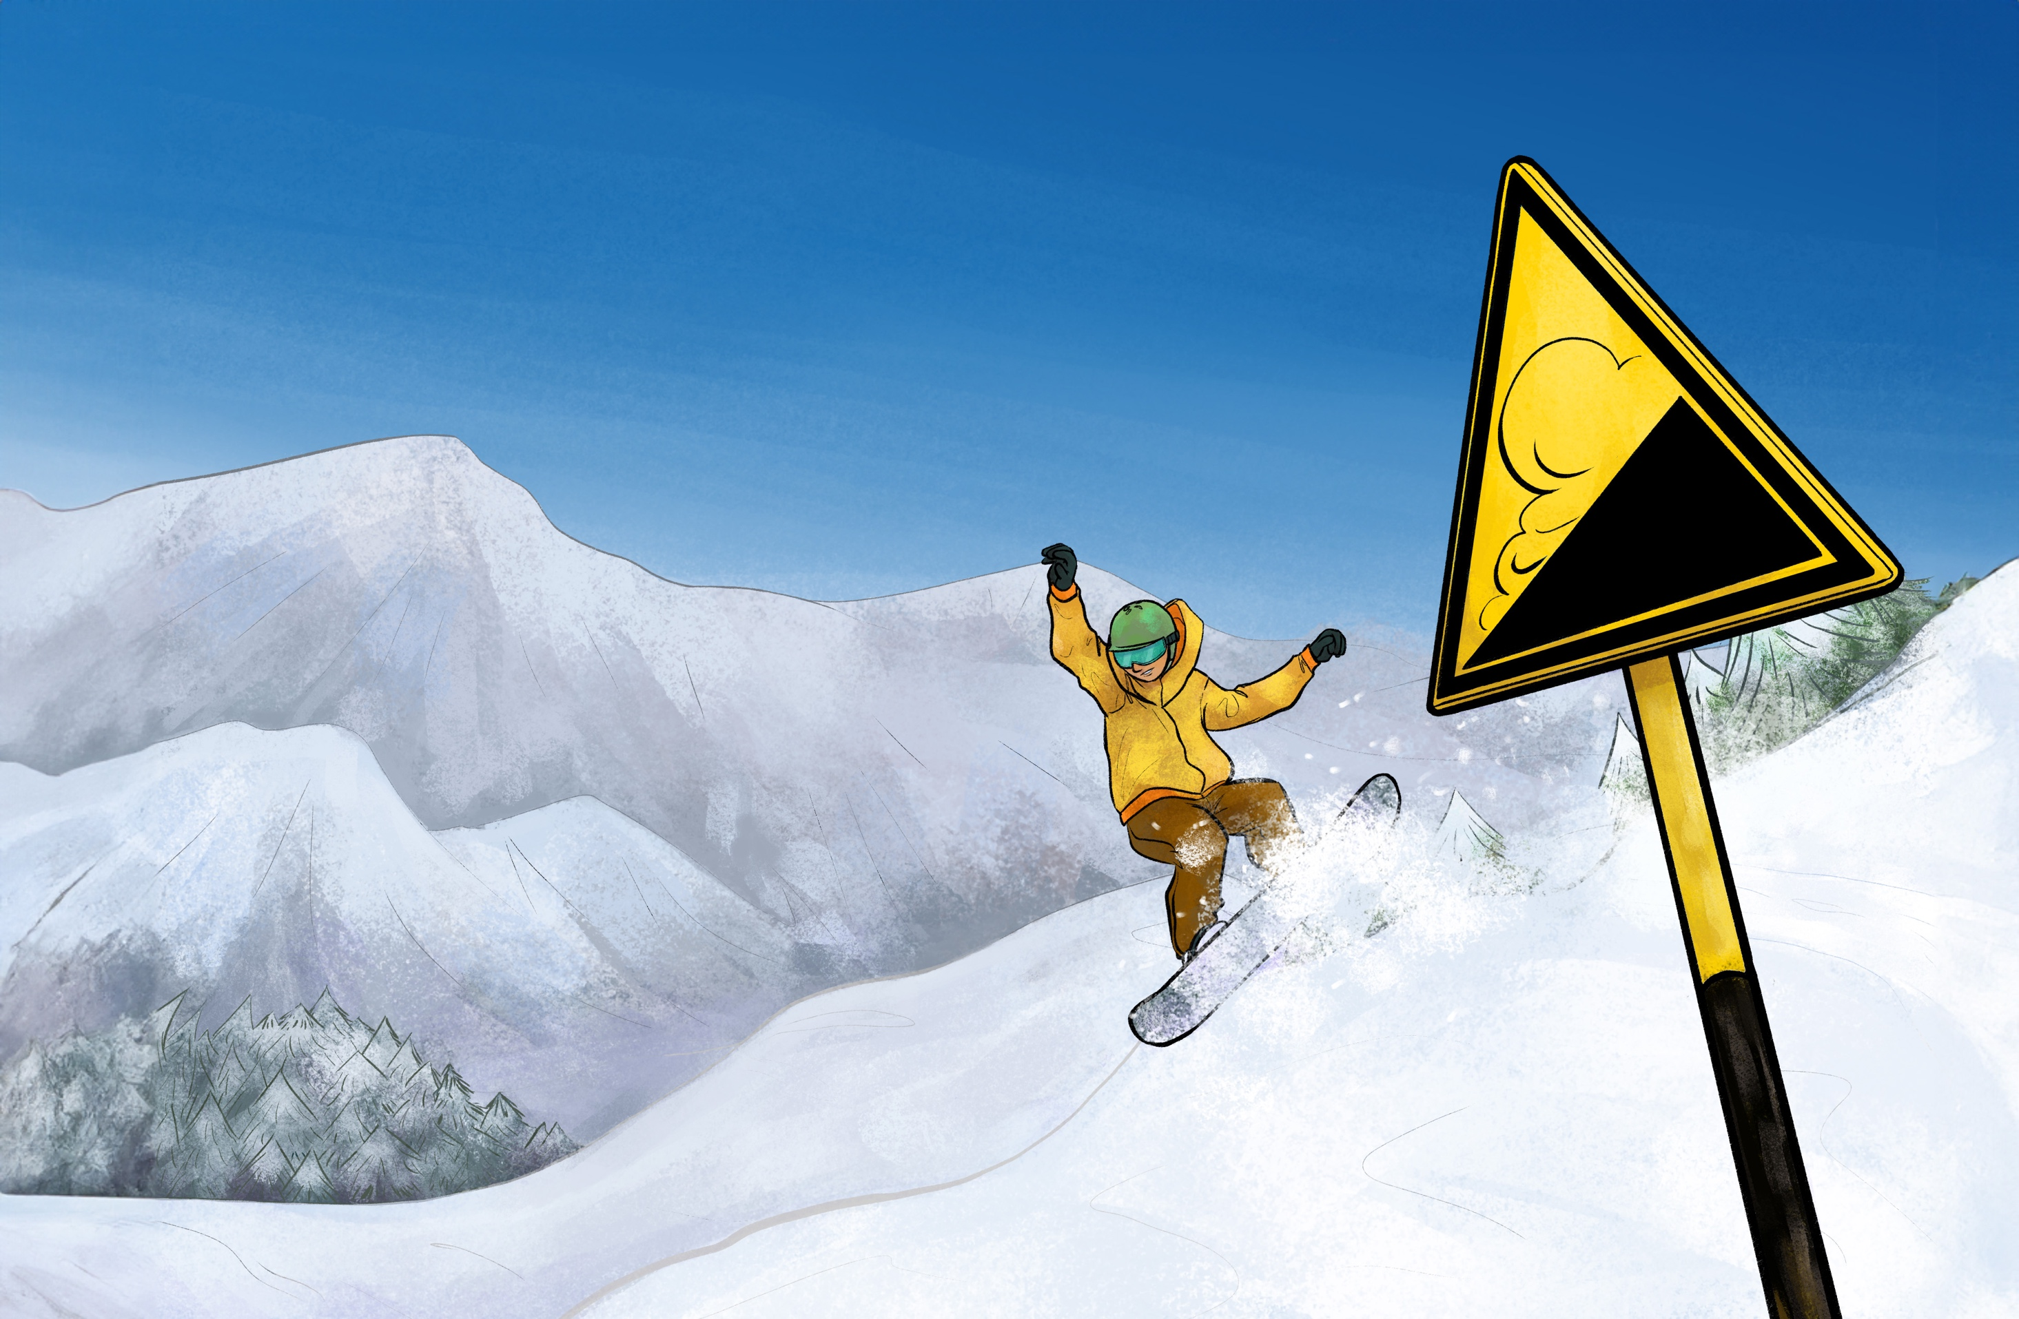
The beginning of the end
The missed opportunity to repent
Visual 13

Slide 35
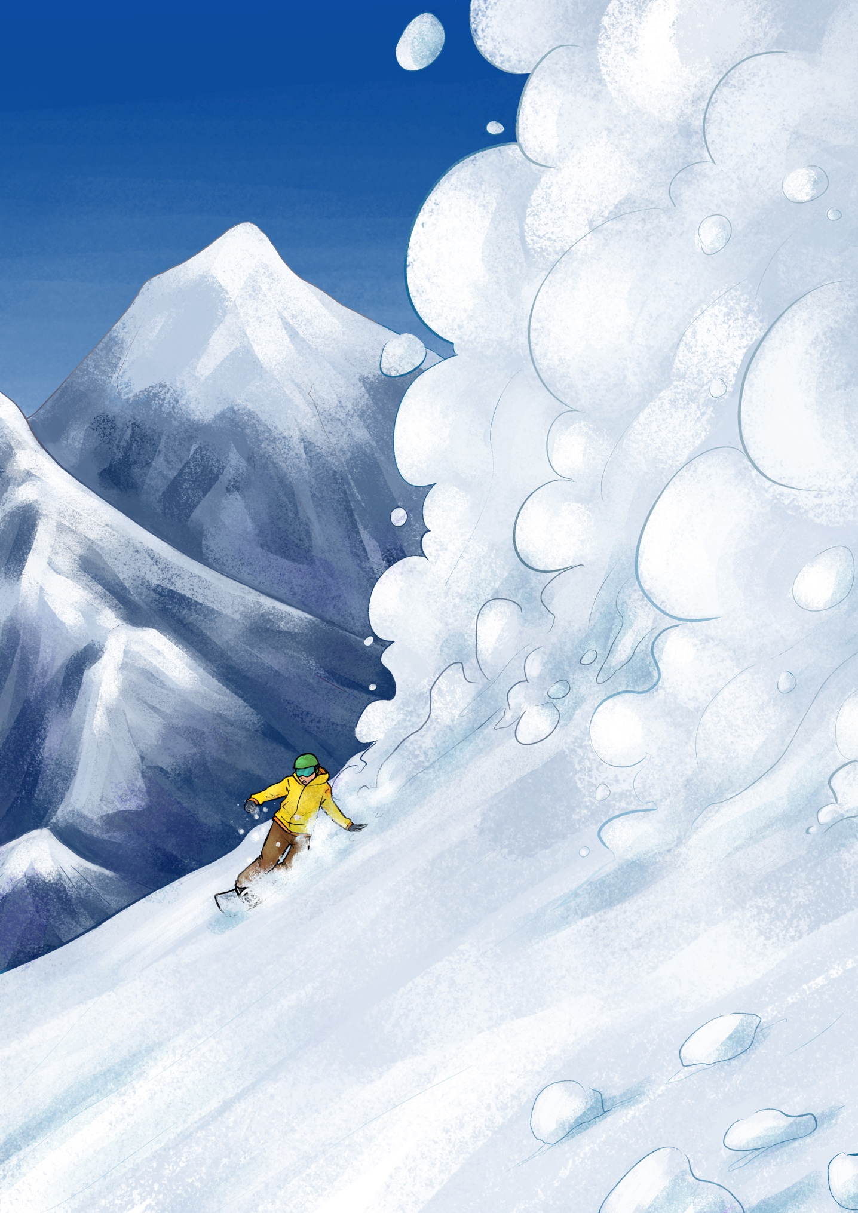
Judas
The act of betrayal
The tragedy of it all
Visual 14

Slide 36
Copyright 2023 © Child Evangelism Fellowship of Europe. All rights reserved.

Slide 37
Lesson 8
Copyright 2023 © Child Evangelism Fellowship of Europe. All rights reserved.

Slide 38
WHO
AM I?
Visual 2

Slide 39
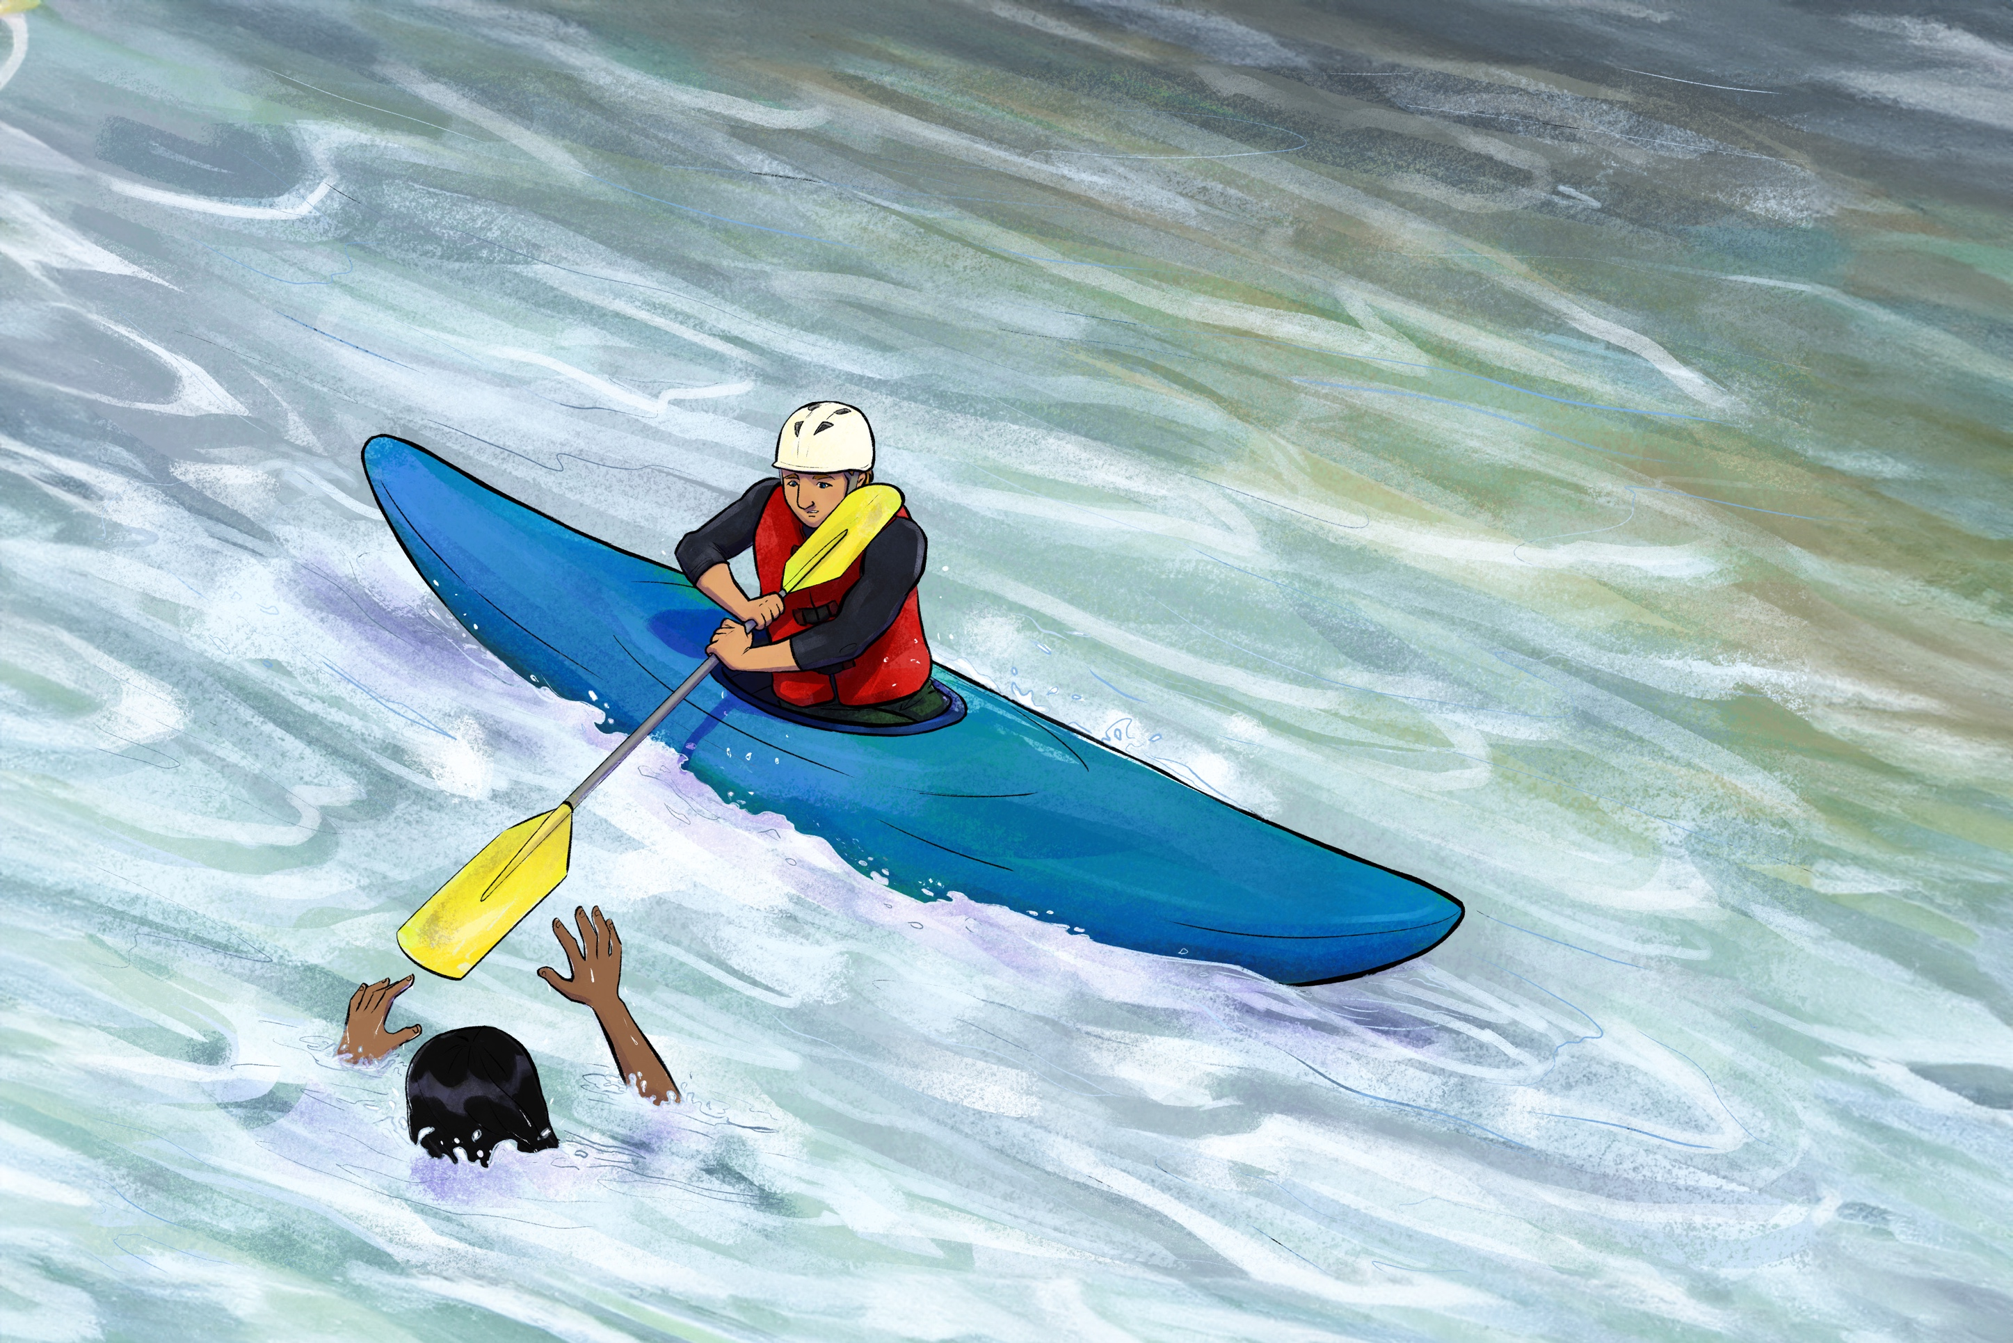
Andrew
Becoming a ‘fisher of men’
Leading family members to the Saviour
Visual 15

Slide 40
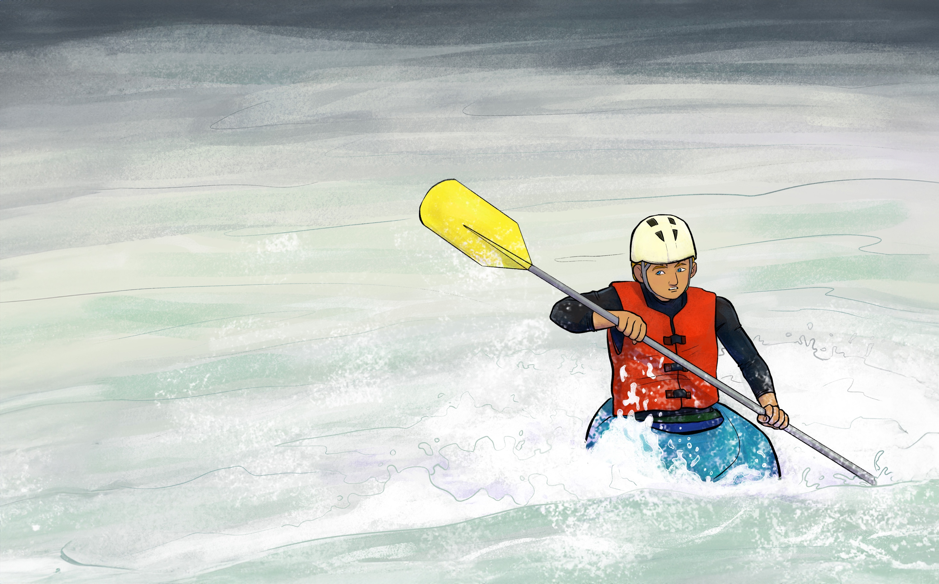
Andrew
Leading children to the Saviour
Leading others to the Saviour
Visual 16

Slide 41
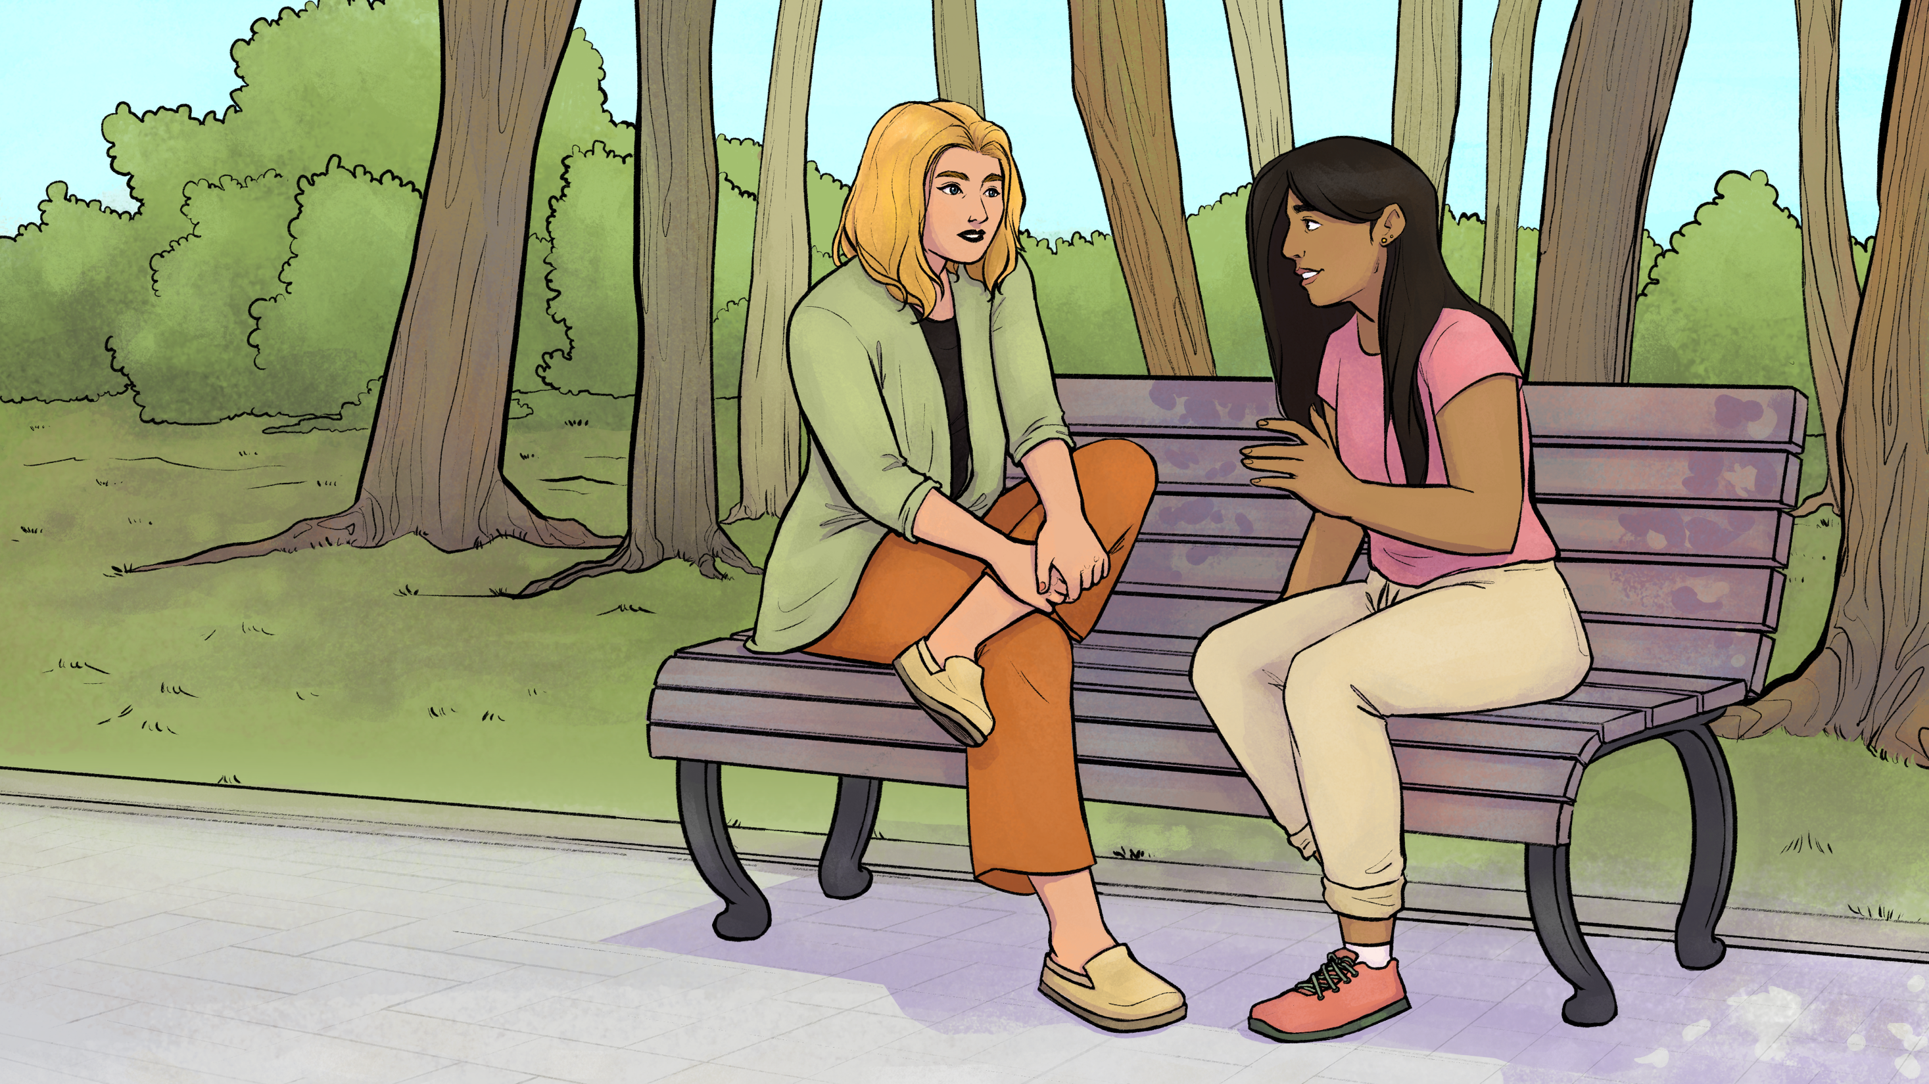
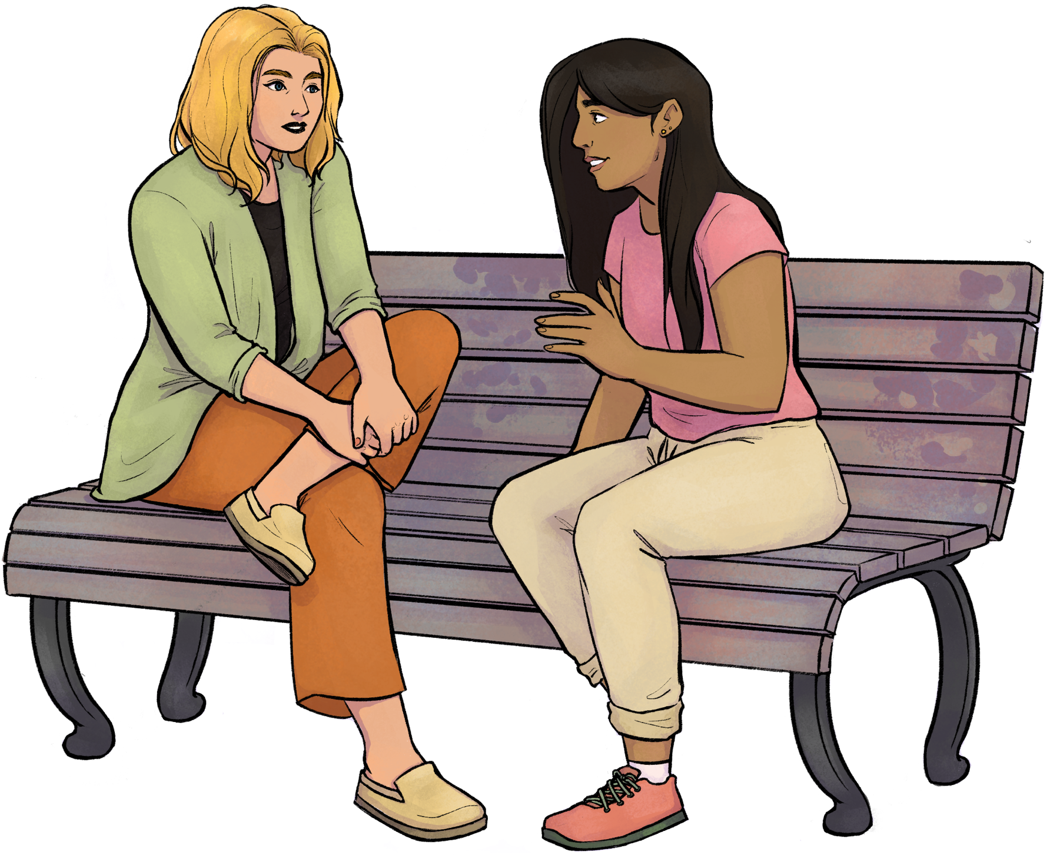
Sharing
YOUR
testimony
Visual 17

Slide 42
Copyright 2023 © Child Evangelism Fellowship of Europe. All rights reserved.

Slide 43
Lesson 9
Copyright 2023 © Child Evangelism Fellowship of Europe. All rights reserved.

Slide 44
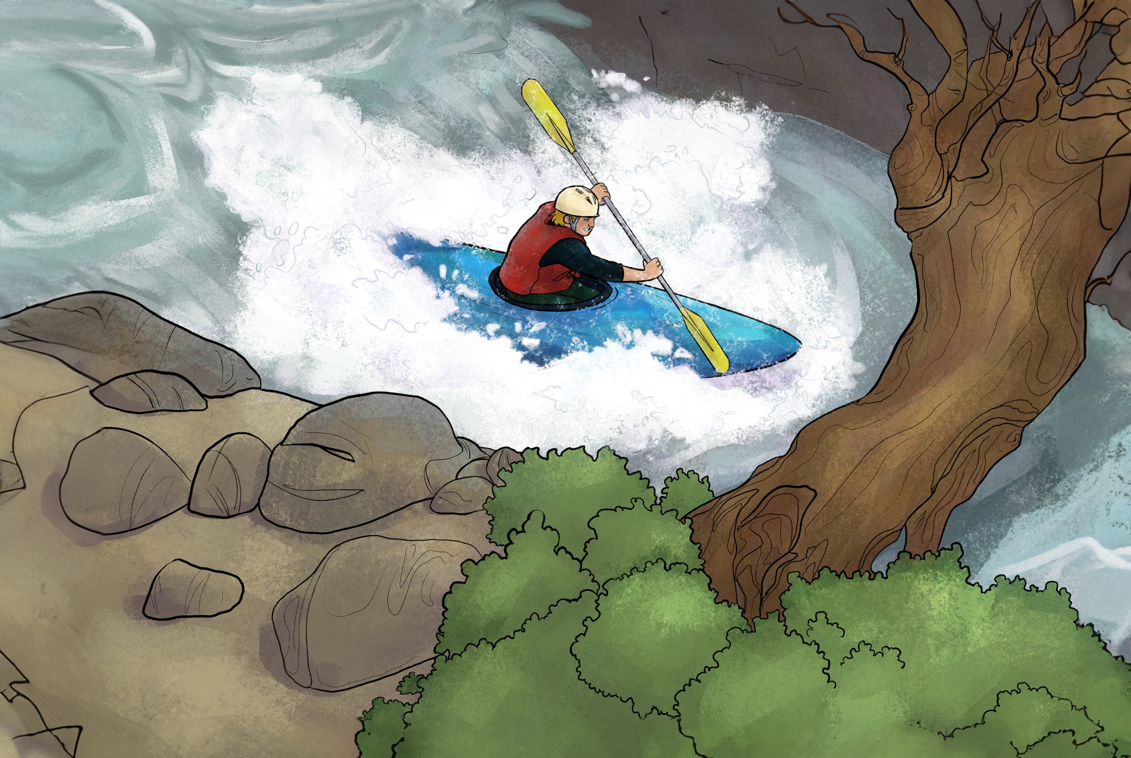
Fear of being laughed at
Fear of being rejected
Fear of being lost for words
Fear of people pointing out our faults
Barriers to witnessing
Visual 18

Slide 45
Romans 10:9–10
GOD
Believe
Receive
Romans 3:23
All have sinned
Romans 5:8
Christ died for us
Romans 6:23
Sin earns spiritual death
SIN
Ephesians 2:8–9
Redemption is a free gift
Hebrews 9:27
Judgement is coming
John 1:12
We must believe and receive Jesus as Lord and Saviour
BAD NEWS
GOOD NEWS
Visual 19

Slide 46
Copyright 2023 © Child Evangelism Fellowship of Europe. All rights reserved.

Slide 47
Lesson 10
Copyright 2023 © Child Evangelism Fellowship of Europe. All rights reserved.

Slide 48
WHO
AM I?
Visual 2

Slide 49
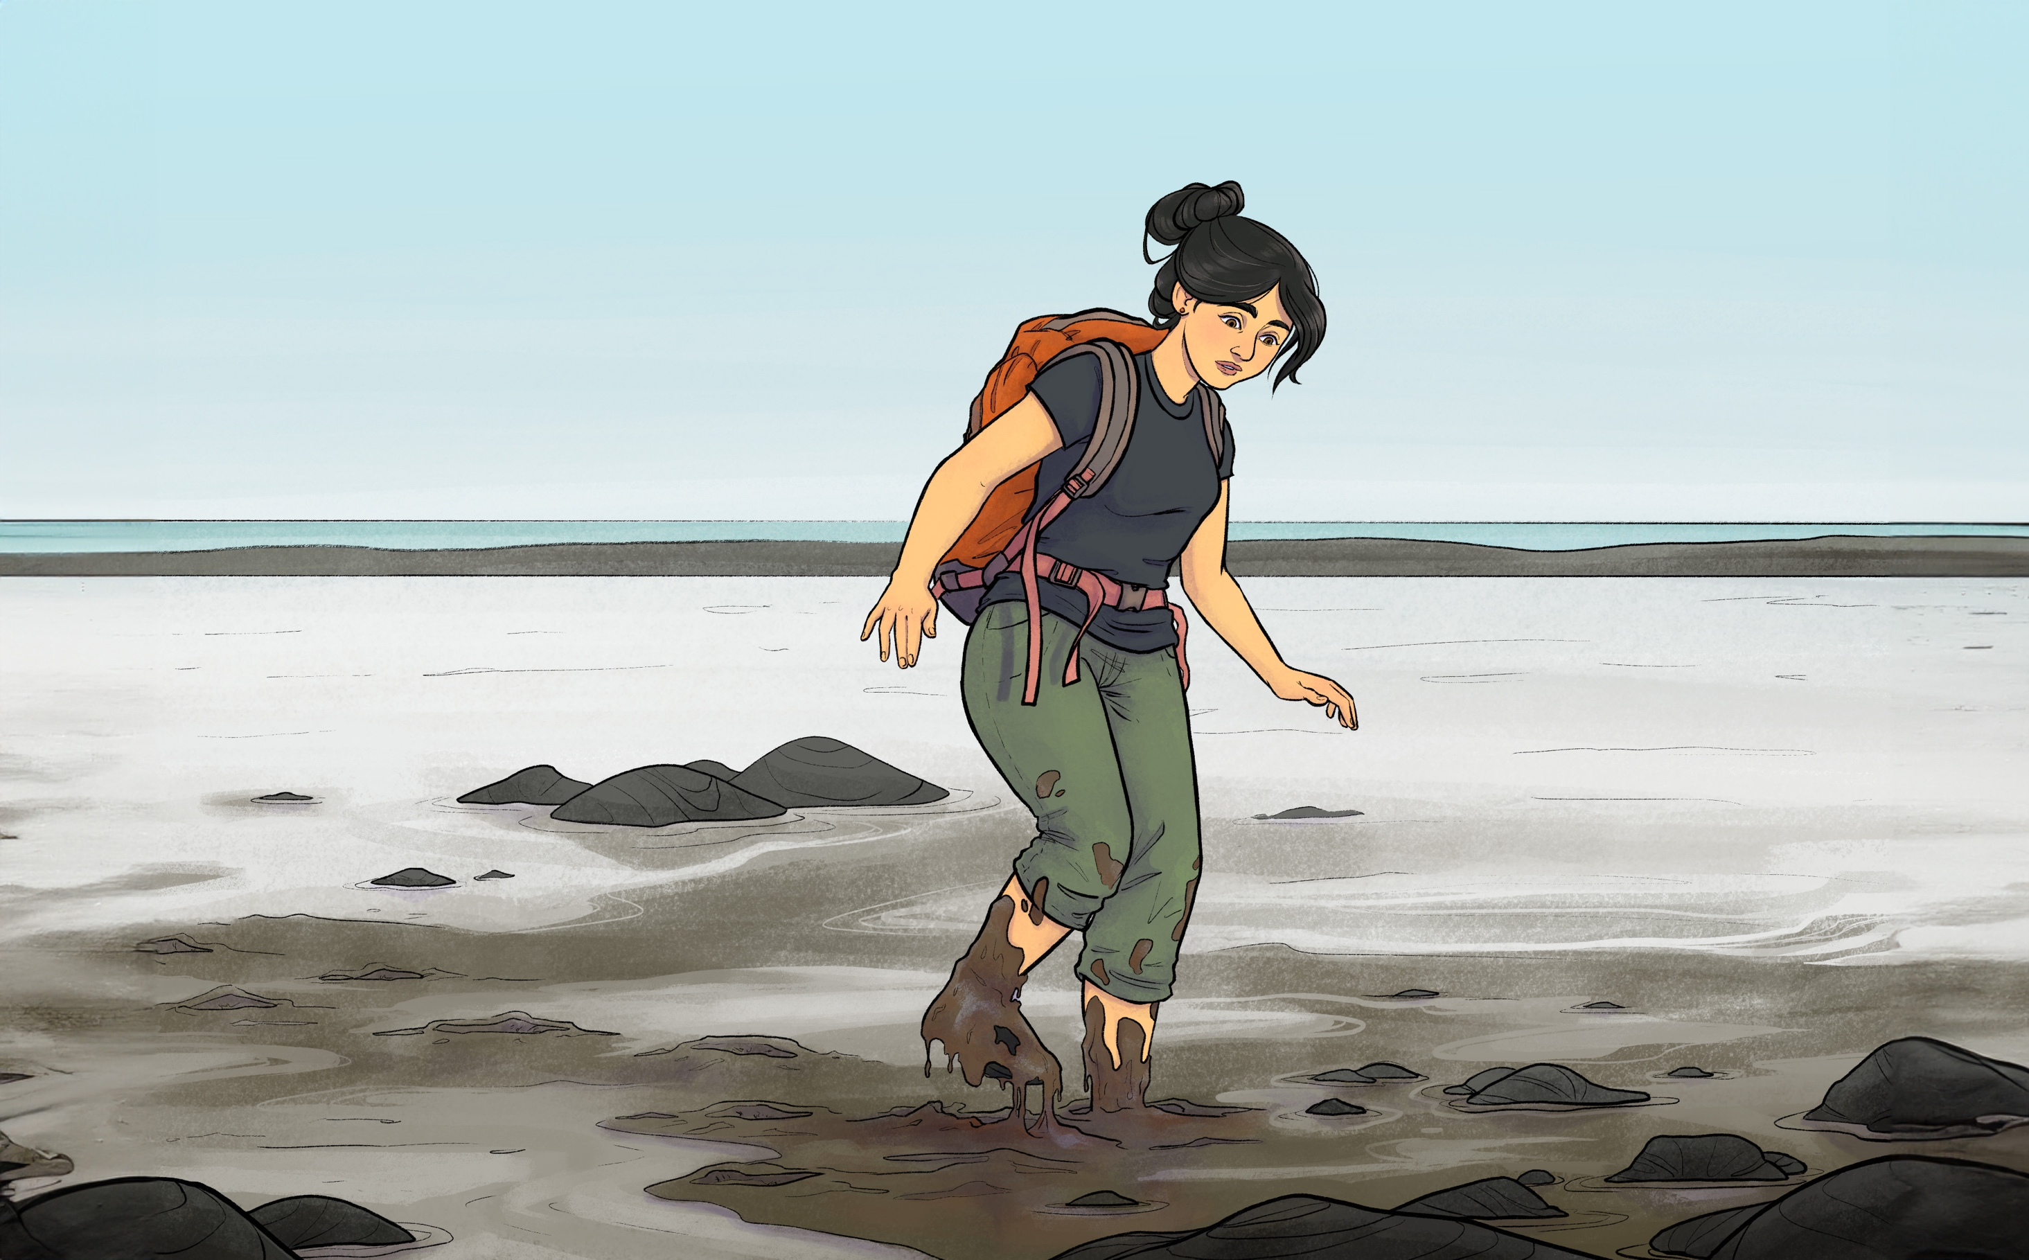
Mary
suggestive lyrics
violent video games
bad friends
inappropriate media
inappropriate websites
bad friends
social media addiction
reading horoscopes
harmful substances
Visual 20

Slide 50
Copyright 2023 © Child Evangelism Fellowship of Europe. All rights reserved.

Slide 51
Lesson 11
Copyright 2023 © Child Evangelism Fellowship of Europe. All rights reserved.

Slide 52
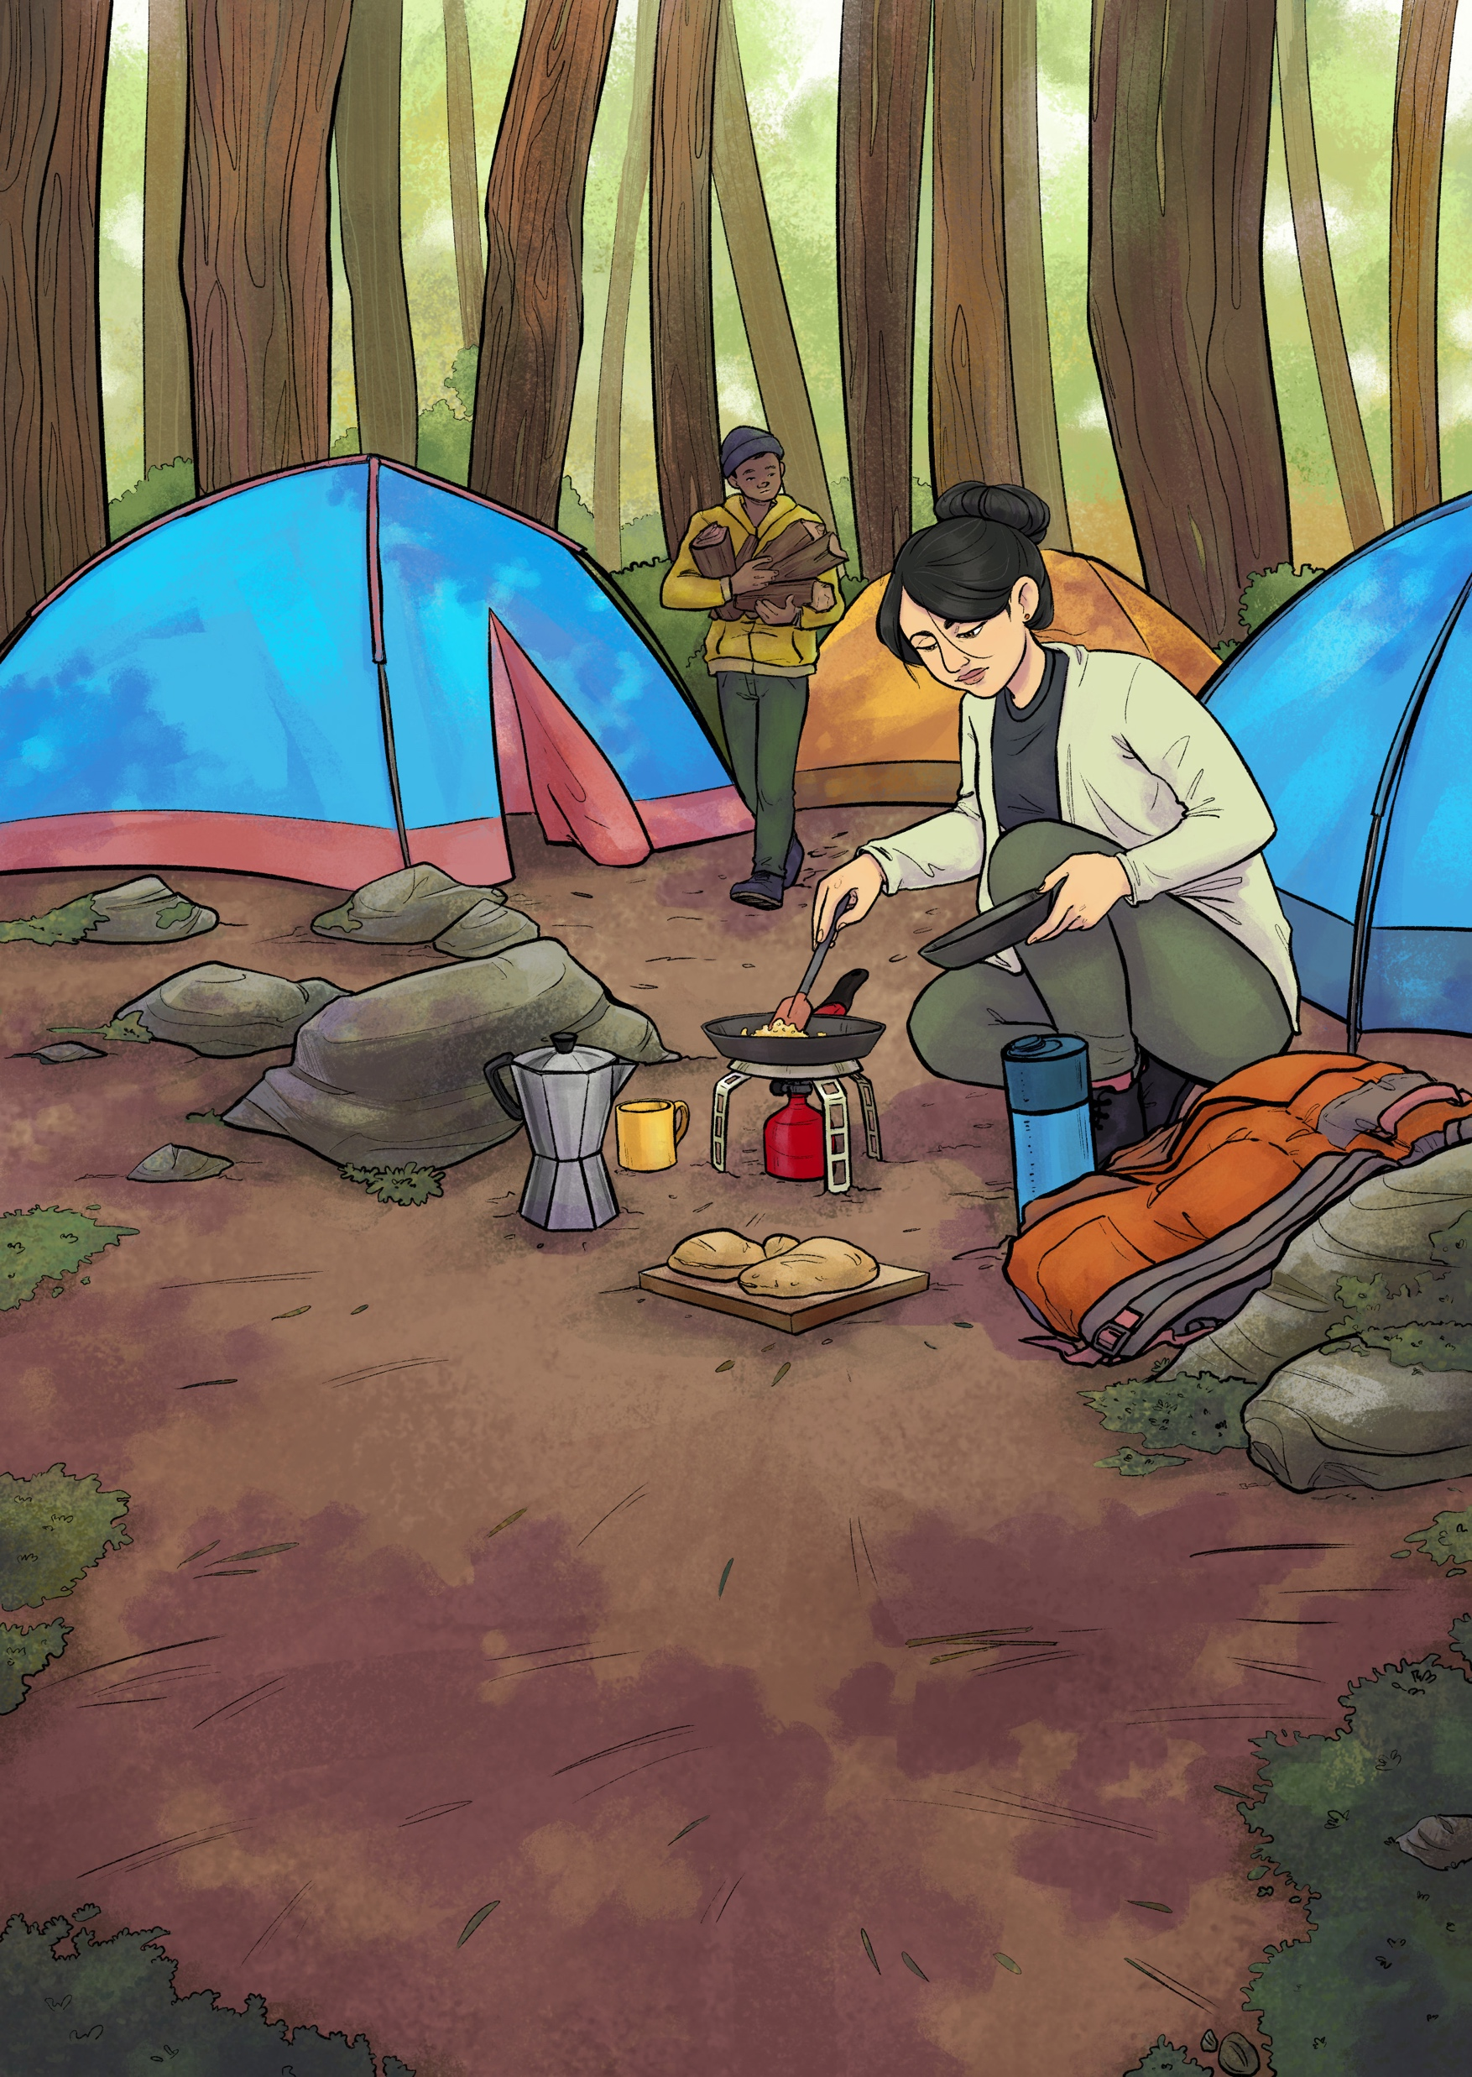
Mary
Money
LUKE 8:1–3
Time
MATTHEW 27:55-56
Acts of Love
MATTHEW 27:59-61 • JOHN 19:25
Mary meets the risen Lord
JOHN 20:1-18
Visual 21

Slide 53
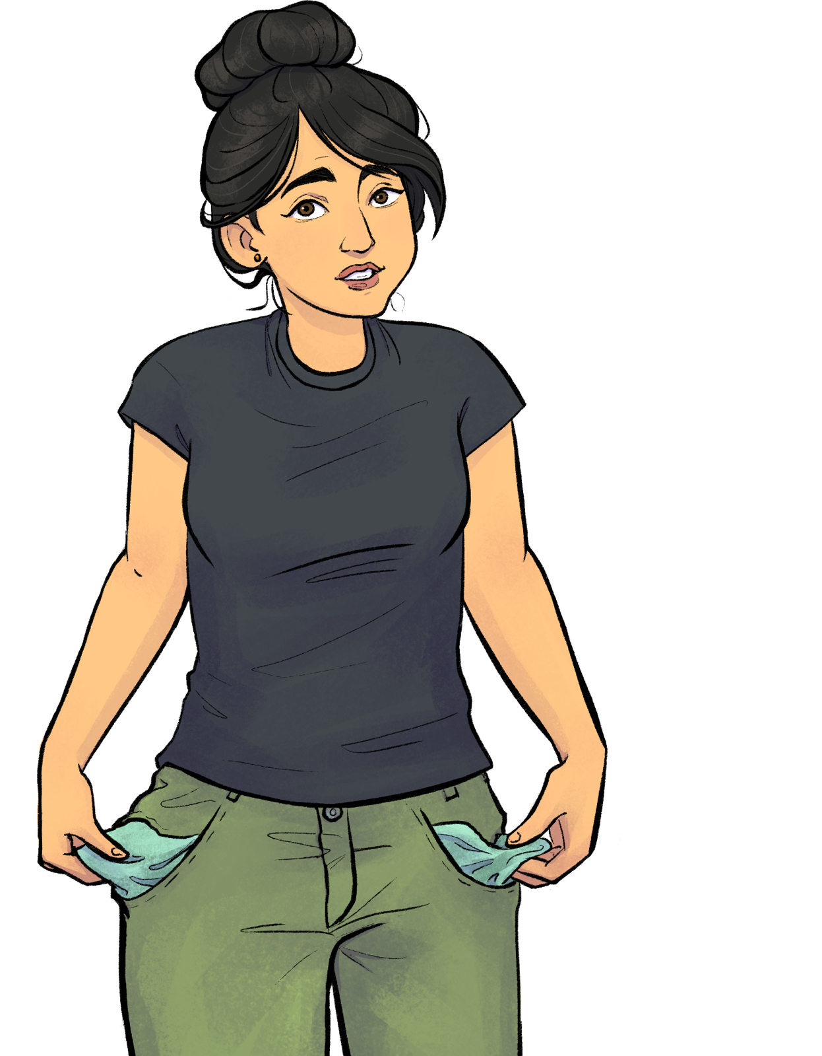
WHAT CAN I GIVE
?
Visual 22

Slide 54
Copyright 2023 © Child Evangelism Fellowship of Europe. All rights reserved.

Slide 55
Lesson 12
Copyright 2023 © Child Evangelism Fellowship of Europe. All rights reserved.

Slide 56
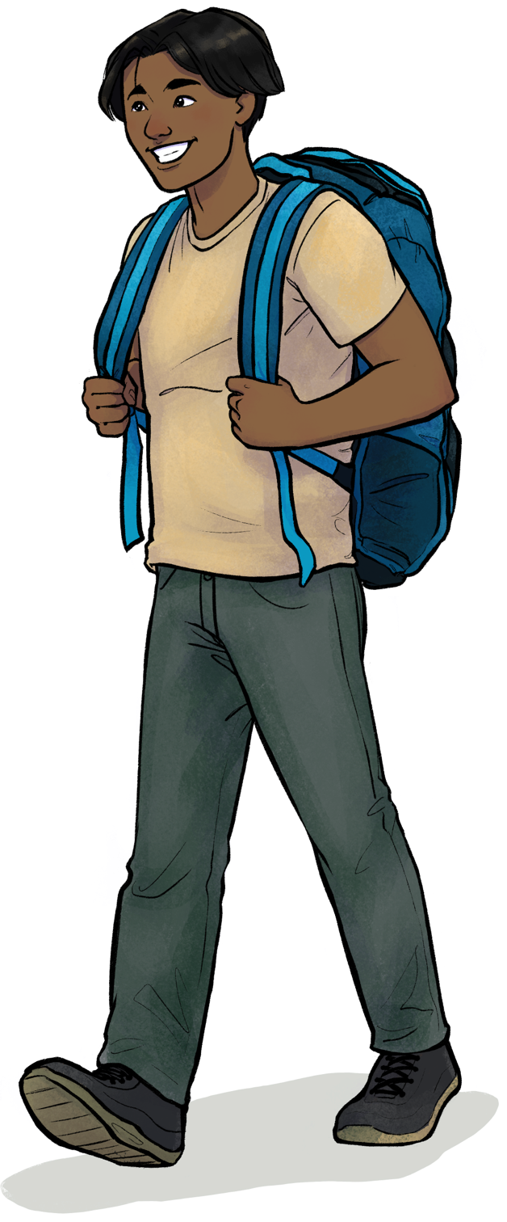
Being a
true follower
SPEND MUCH TIME IN PRAYER
BE ACTIVE IN THE LOCAL CHURCH
STUDY GOD’S WORD DAILY
GROW TO BE MORE LIKE JESUS
LIVE EXPECTANTLY
MAKE DISCIPLES
LOVE AND TELL OTHERS
Visual 22

Slide 57
Judas
WHY
Follow
Jesus?
Pretending To Follow
On The Road To Ruin
Peter
Andrew
Changed Forever
Failures and Victories
Bringing Others To Jesus
Sharing The Message
Being a true follower
Mary
John
Freed From Sin
Empowered To Serve
A Devoted Follower
Looking Forward

Slide 58
Copyright 2023 © Child Evangelism Fellowship of Europe. All rights reserved.

